Slide 1
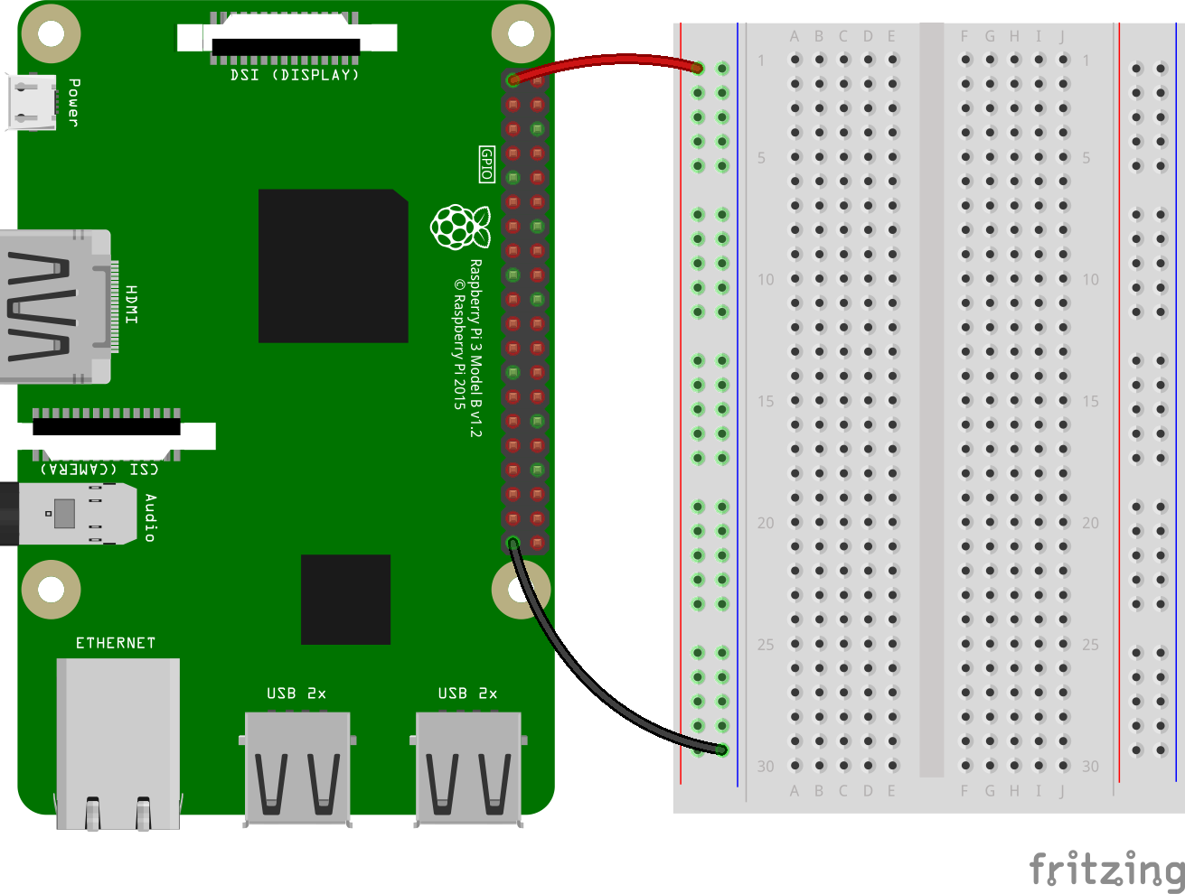
Hands On: Getting Started
Make a closed circuit:
Connect 3v3 pin with “red” column
Connect GND pin with “blue” column

Slide 2
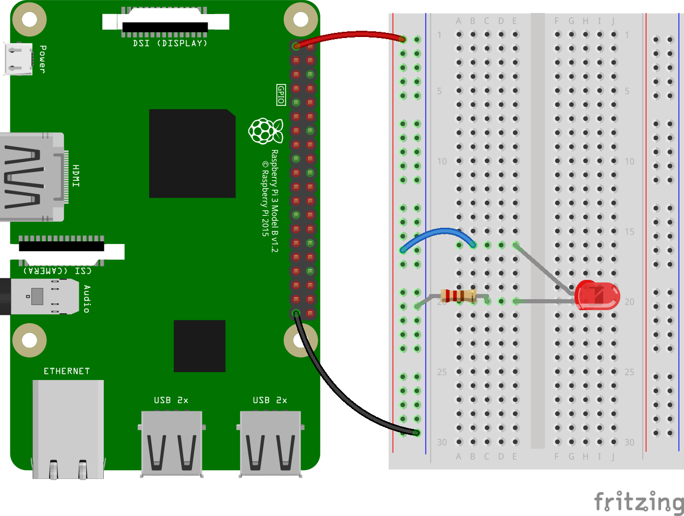
Hands On: LED
How to turn LED on?
Put the long side (kathode/+) of LED on E16, and short side (anode/-) of LED on E20
Put one end of the resistor on C20 and the other on any point near the “blue” column
Using a jumper wire, connect the “red” column with point B16
LED will now turn on!

Slide 3
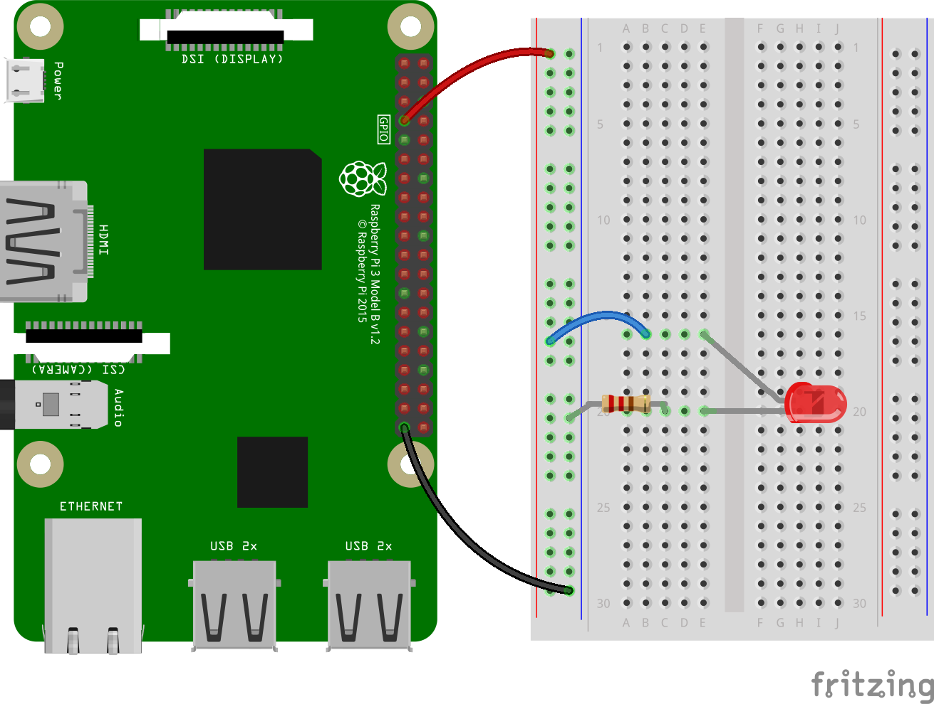
Hands On: LED
How to control LED using GPIO pins?
Move the jumper wire from 3v3 to GPIO4
LED will now turn off - but we can now control the LED’s behavior through code!

Slide 4
Hands On: LED
from gpiozero import LED
led = LED(4) # the GPIO pin from above
led.on() # turn on
led.off() # turn off
For references: https://gpiozero.readthedocs.io/en/stable/api_output.html#led

Slide 5
Hands On: LED
Break down in groups of 2-3 students to replicate the previous demonstration.
Challenges:
How to make LED blink 10 times? (Hint: use a combination of sleep() and a for loop)
How to make LED blink continuously? (Hint: use a combination of sleep() and a while loop)

Slide 6
Hands On: LED
How to make LED blink 10 times?
from gpiozero import LED
import time
led = LED(4)
for i in range(10):
led.on()
time.sleep(1)
led.off()
time.sleep(1)
from gpiozero import LED
led = LED(4)
led.blink(on_time=1, off_time=1, n=10)

Slide 7
Hands On: LED
How to make LED blink continuously?
from gpiozero import LED
import time
led = LED(4)
while True:
led.on()
time.sleep(1)
led.off()
time.sleep(1)
from gpiozero import LED
led = LED(4)
led.blink(on_time=1, off_time=1)

Slide 8
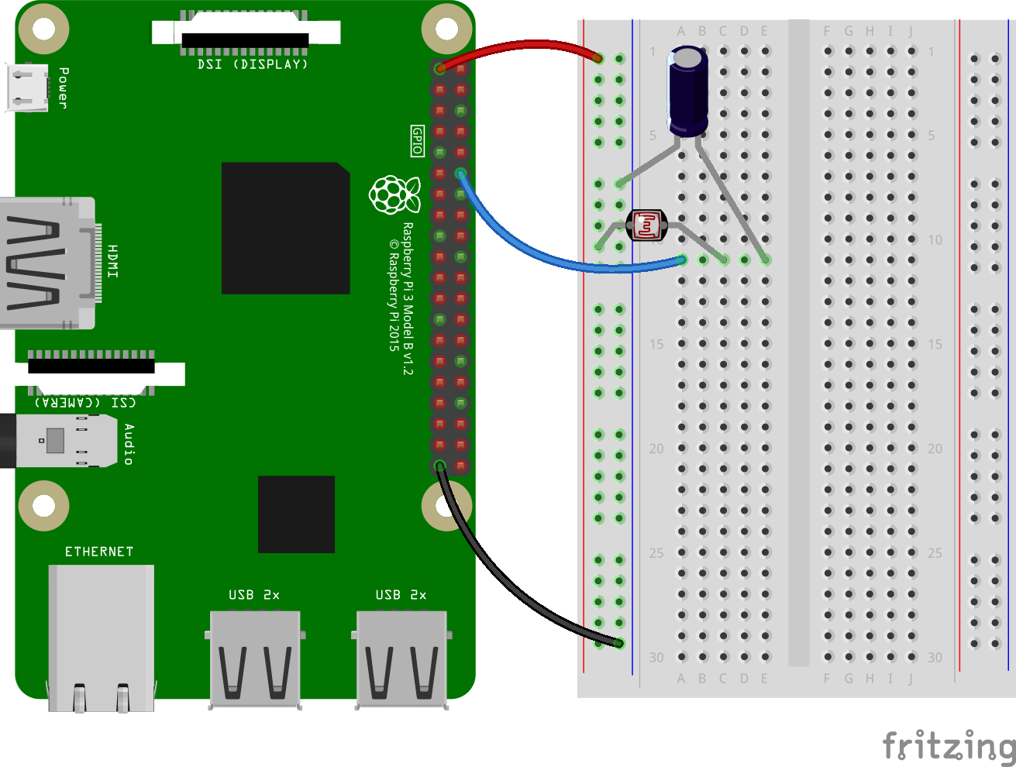
Hands On: LDR
How to use a light sensor?
Put long side (kathode/+) of capacitor on E11 and short side of capacitor (anode/-) on “blue” column
Connect GPIO18 to A11
Put LDR on point C11 and “red” column

Slide 9
Hands On: LDR
from gpiozero import LightSensor
ldr = LightSensor(18) # the GPIO pin from above
while True:
print(ldr.value) # number between 0 (dark) and 1 (light)
For references: https://gpiozero.readthedocs.io/en/stable/api_input.html#lightsensor-ldr

Slide 10
Hands On: LDR
Break down in groups of 2-3 students to replicate the previous demonstration.
Challenges:
Make a program output/print something (e.g. “It’s light!”) when the LDR value exceeds a certain threshold. (Hint: use a combination of while loop and print)

Slide 11
Hands On: LDR
Make a program output/print something (e.g. “It’s light!”) when the LDR value exceeds a certain threshold.
from gpiozero import LightSensor
ldr = LightSensor(18)
while ldr.value < 0.5:
continue
print("It's light!")
from gpiozero import LightSensor
ldr = LightSensor(18, threshold=0.5)
ldr.wait_for_light()
print("Light detected!")

Slide 12
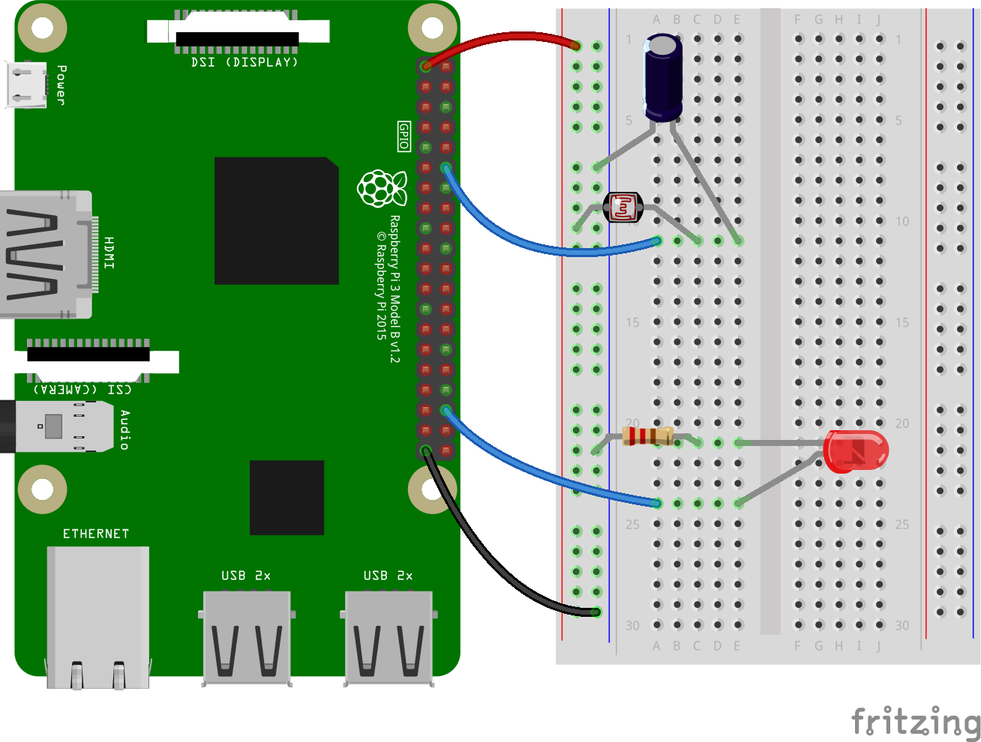
Hands On: Smart Lamp
How to make a smart lamp? (cont. from previous schematics)
Put resistor on “blue” column and C21
Put LED’s long side (kathode/+) on E24, and the short side (anode/-) on E21
Connect GPIO16 to A24

Slide 13
Hands On: Smart Lamp
from gpiozero import LightSensor, LED
from signal import pause
sensor = LightSensor(18)
led = LED(16)
sensor.when_dark = led.on
sensor.when_light = led.off
pause()

Slide 14
Hands On: Smart Lamp
Break down in groups of 2-3 students to replicate the previous demonstration.
Challenges:
Instead of making the LED turn on or off, adjust the brightness of the LED according to the value read by the LDR (Hint: use PWMLED here instead of LED)
When it’s bright, LED is also bright. When it’s dark, LED is dim.
When it’s dark, LED is bright. When it’s bright, LED is dim.

Slide 15
Hands On: Smart Lamp a)
from gpiozero import LightSensor, PWMLED
from signal import pause
sensor = LightSensor(18)
led = PWMLED(16)
led.source = sensor
pause()

Slide 16
Hands On: Smart Lamp b)
from gpiozero import LightSensor, PWMLED
from signal import pause
sensor = LightSensor(18)
led = PWMLED(16)
def opposite(sensor_object):
for v in sensor_object.values:
yield 1 - v
led.source = opposite(sensor)
pause()

Slide 17

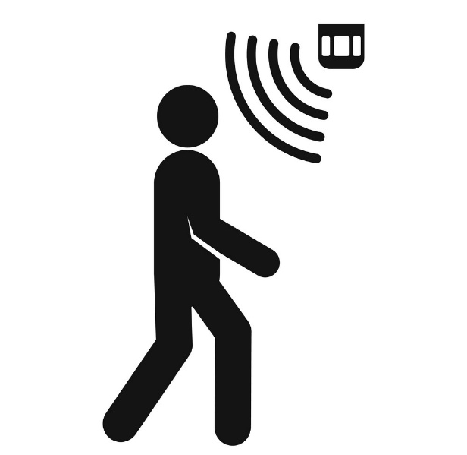
Bonus Challenge
Integrate Motion Sensor with
your Smart Lamp system

Slide 18
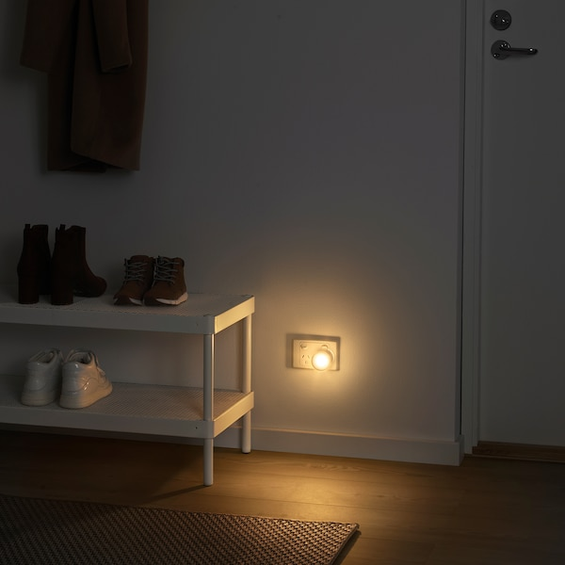
Smart Lamp Bonus Challenge
Integration of Motion Sensor with your existing LDR + LED Smart Lamp circuit
Set up Motion Sensor + LED
Example idea:
When there is motion -> turn on light
When there is no motion -> turn off light
Set up Motion Sensor + LDR + LED
Example idea:
Night light turns on/off based on both:
The environment’s brightness
The detected motion

Slide 19
Refer to the Bonus slides for more details

Slide 20
Appendix
https://gpiozero.readthedocs.io/en/stable/index.html
https://projects.raspberrypi.org/en/projects/physical-computing/0
https://lets-code-p.github.io/teaching/
https://fritzing.org/

